Slide 1

The Ruby Masterclass

Slide 2
What is Ruby
Ruby is “A dynamic, open source programming language with a focus on simplicity and productivity. It has an elegant syntax that is natural to read and easy to write. ”
- ruby-lang.org

Slide 3
Why Ruby?

Slide 4
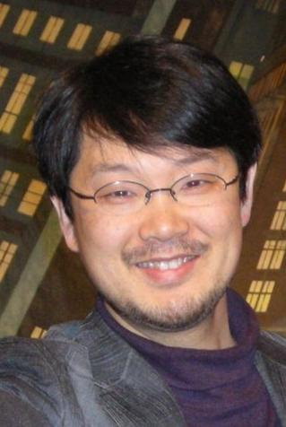
Ruby is A Purely Object Oriented, general purpose, easy to use programming language primarily focuses on simplicity, creativity and power.
Released in 1995 by a Japanese computer scientist,
Yukihiro Matsumoto (“Matz”).
One of the top 10 programming languages worldwide.
Open Source implementation.
Can be used for system administration, game development, UI development, data science, cryptography, ethical hacking, AI, and other applications. Ruby on Rails, a popular web framework, is written in Ruby.
One of the most beginner friendly language.

Slide 5

A Brief Comparison Between C and Ruby

Slide 6


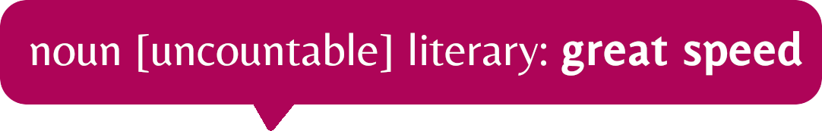
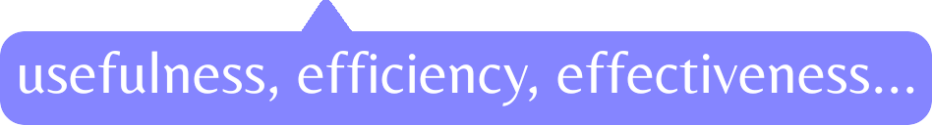
Matz Ruby Interpretation is written in C.
C for Celerity – R for Robustness.
Ruby is one of the purely Object Oriented programming languages.
For developers, C codes be used with Ruby.
Ruby as a very handy scripting language.

Slide 7

A Brief Comparison between Python, Perl, C++ and Ruby

Slide 8



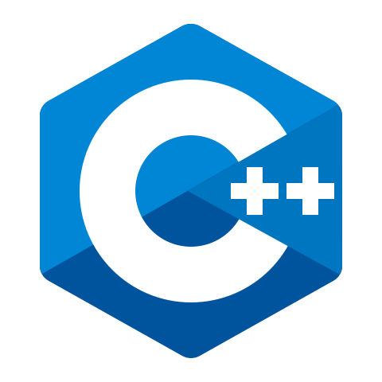
Python
Perl
Ruby
C++

Slide 9

Installating Ruby and Getting Started

